Slide 1
Data and Storytelling: Supporting Equitable Access to Care for Veterans
Shweta Ghimire
November 9, 2022

Slide 2
Disclosures
Presenter: Shweta Ghimire
Co-Authors: Chelsea Chokas, Annaliese Cothron
Financial Disclosure: Speaker and Co-authors do not have any relevant financial relationships to disclose.
The NC Oral Health Section Continuing Education Program is responsible for ensuring the content, quality, and scientific integrity of all continuing education activities.
No commercial support has been received for this continuing education activity.

Slide 3
Learning Objectives
Evaluate the current landscape and drivers of veteran oral health
Understand the impact and context surrounding inadequate access to veteran oral health
Identify opportunities to improve veteran oral health using data-driven tools resources

Slide 4
Exploration of Veteran Oral Health
Literature review exposed a fragmented oral health system and little available data
Lack of available resources led to the launch of the 2021 Veteran Oral Health Survey
Combed additional data sources for veteran specific data
BRFSS
MEPS
Each data source provided a glimpse at the oral health disparities and/or inequities veterans face

Slide 5
Have you experienced the following problems with your mouth in the last 12 months?
Source: 2021 Veteran Oral Health Survey launched by CareQuest Institute for Oral Health and AIDPH

Slide 6
Care Access for Pain or Discomfort
Source: 2021 Veteran Oral Health Survey launched by CareQuest Institute for Oral Health and AIDPH

Slide 7
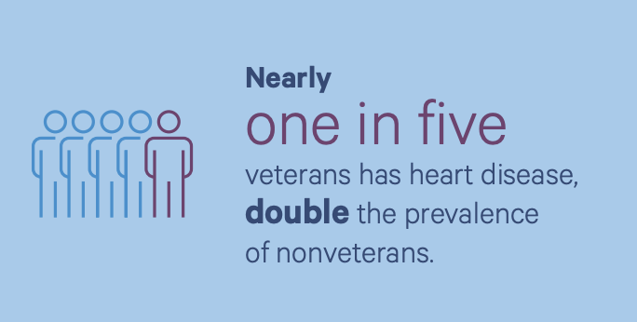
How are veterans’ dental and overall health connected?
Key Takeaway: Veterans experience a disproportionate prevalence of chronic disease.
Approximately 20% of veterans have diabetes compared to 15% of nonveterans
Veterans are aware their oral health is worse than their mental or overall health – and poor oral health exacerbates chronic disease conditions.
Notes:
Although veterans recognize the value of having good oral health, they also consistently rate their dental health as “poor” when compared their self-rating of mental health or overall health.
Veterans disproportionately experience chronic diseases like diabetes and heart disease compared to nonveterans - likely linked to their military service. We know these disease conditions can exacerbate poor oral health and vice versa - poor oral health can exacerbate these chronic disease conditions.
When disease conditions like heart disease and diabetes are supported through consistent access to dental care for periodontal treatment, cost savings are realized for the treatment of the underlying chronic disease condition.

Slide 8
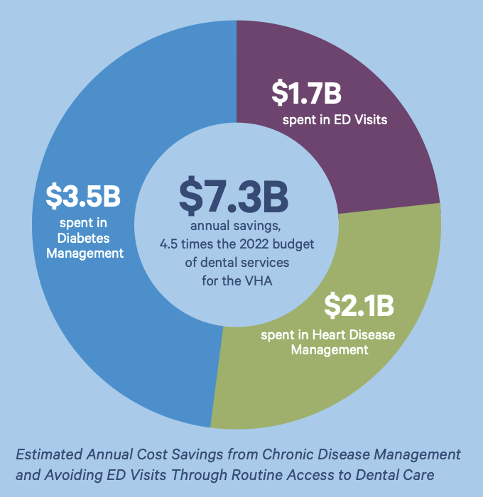
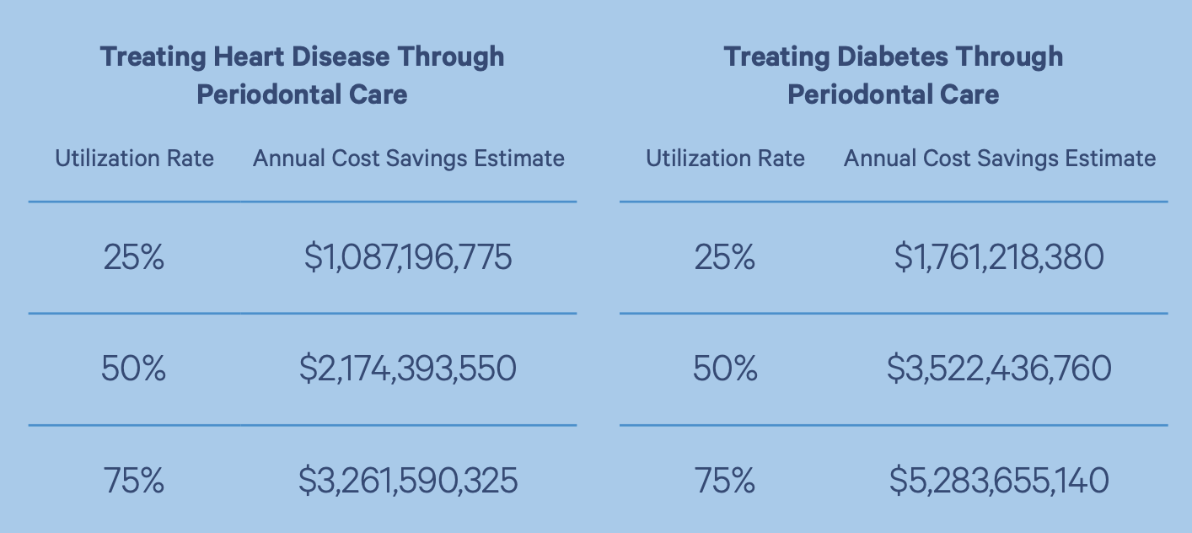
Substantial cost savings can be realized through consistent access to dental care
Notes:
We applied cost savings models that were developed by Cigna health and then projected them at different utilizations rates for veterans. We then projected associated costs from self-reported ED visits in the past year for veterans who responded to our 2021 survey. In that survey 6% of veterans indicated visiting an ED in the last year to address mouth pain - what we now view as a conservative estimate based on additional data collected this year.
Taken together, applying the cost savings from managing heart disease and diabetes through effective dental care at a 50% utilization rate coupled with a cost savings from averting high dental ED costs, we estimate that 7.3 billion dollars can be saved annually - about 4.5 times the 2022 VA budget for dental services.

Slide 9
Putting Data into Action
Desire to share analyses and findings with a broader audience
Coupled existing quantitative and qualitative data with storytelling to show the implications of disease burden
Allow decision-makers, clinicians, advocates, and program leaders to make data-informed inferences about veterans in their state and local community
Understand the “why” behind health outcomes can create opportunities to approach access to care more comprehensively

Slide 10
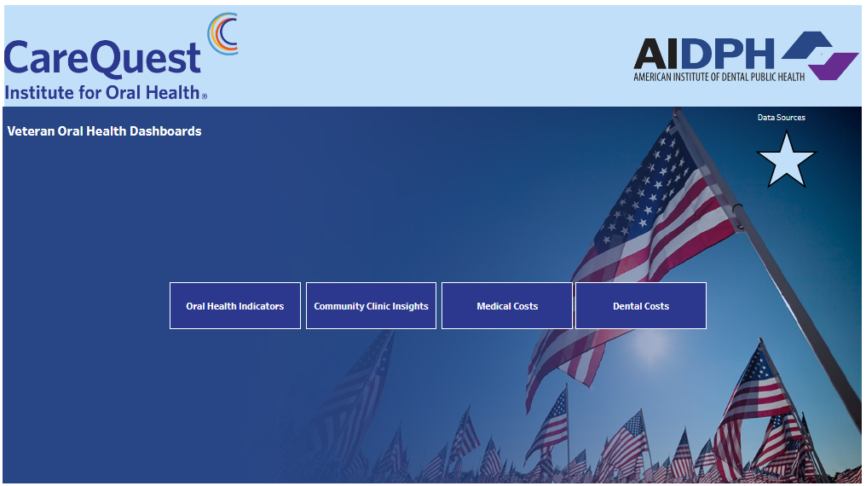
Veteran Oral Health Data Dashboard

Slide 11
How to Use the Veteran Oral Health Dashboard
Looking at trends in chronic disease conditions for your state or region.
Comparing trends in health outcomes between veterans and nonveterans.
Understanding the available infrastructure for veterans to receive dental care in the community.
Analyzing costs for veterans associated with medical and dental expenditures compared to nonveterans.

Slide 13
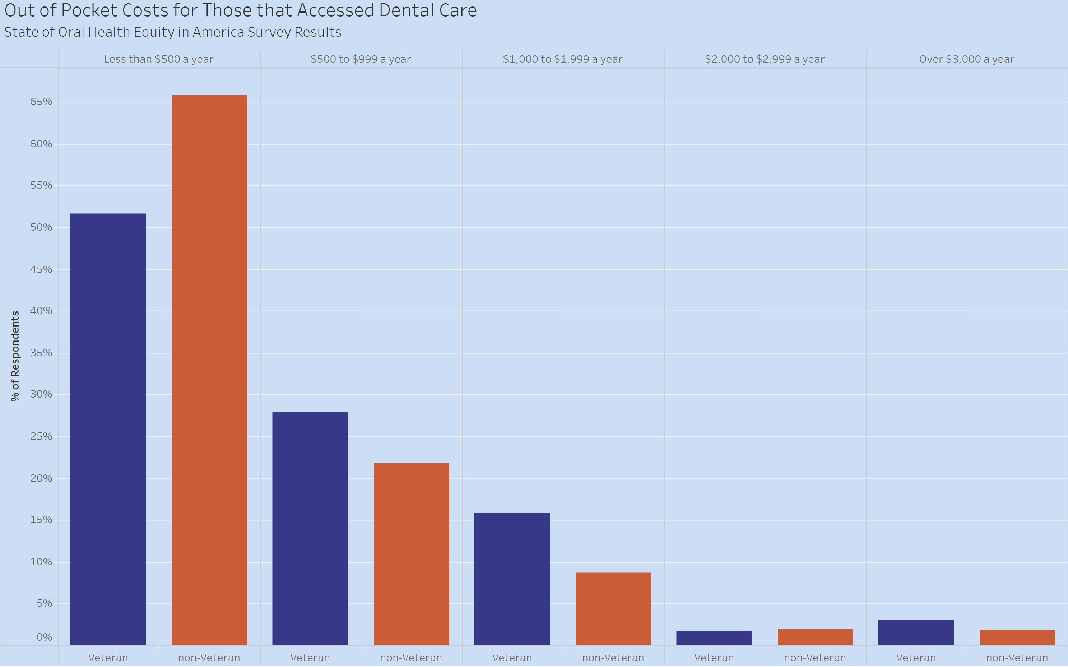
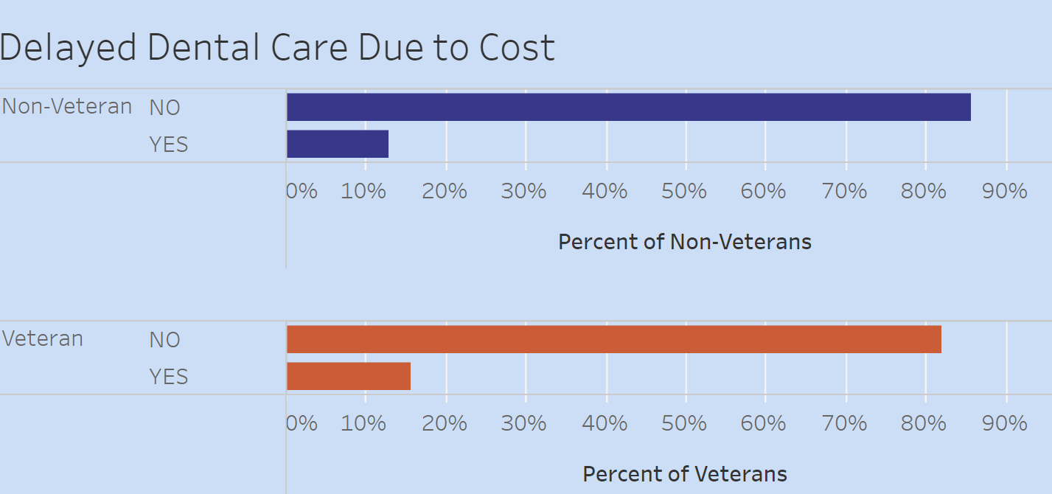

Slide 14
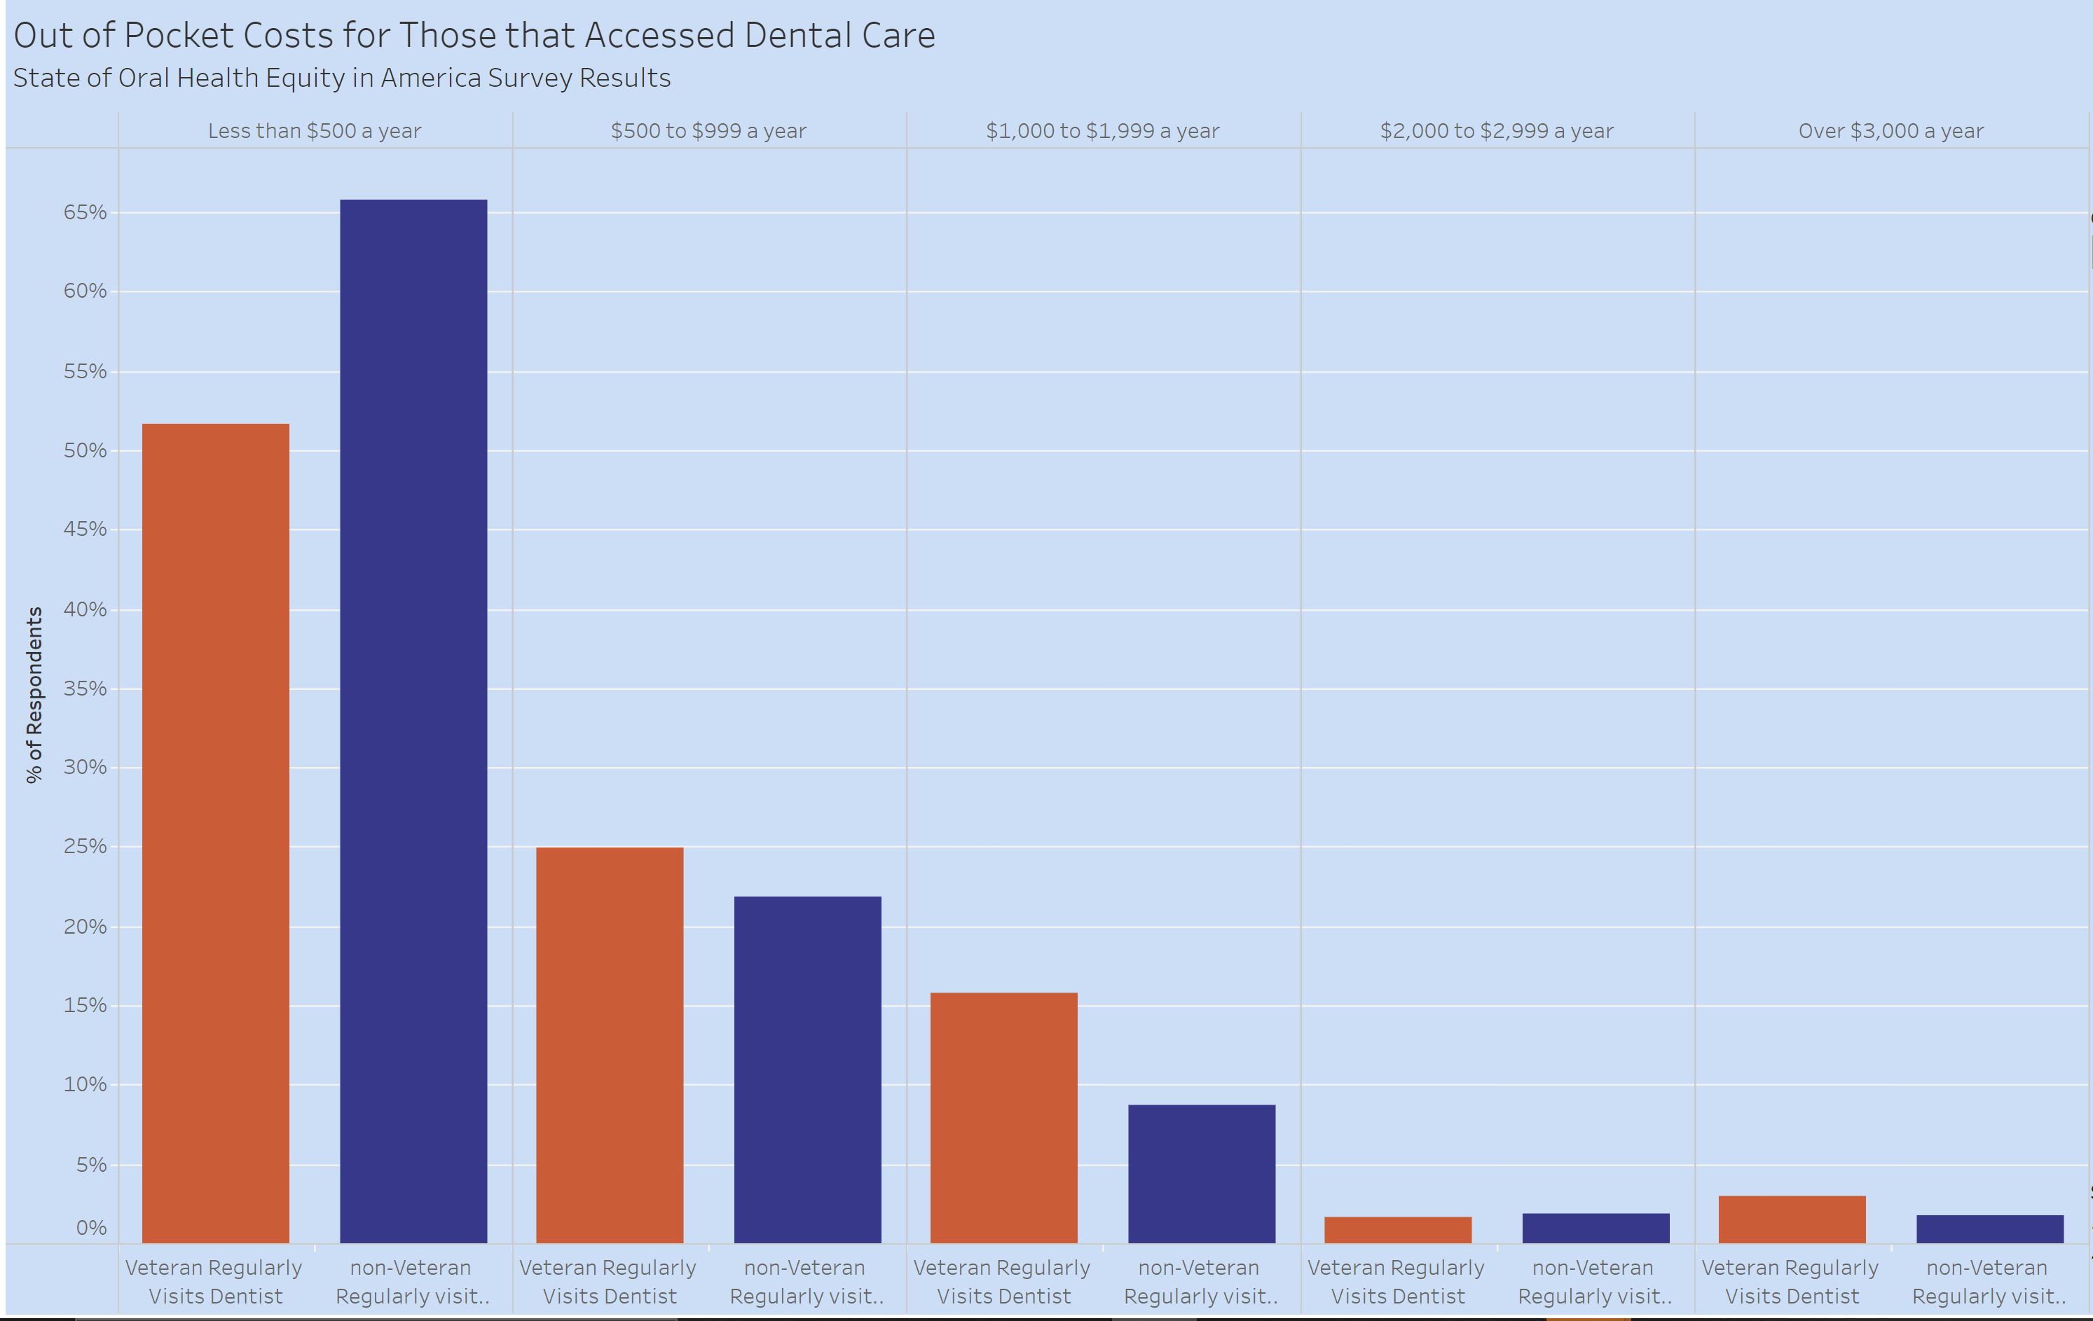
Dashboard Screenshots

Slide 15
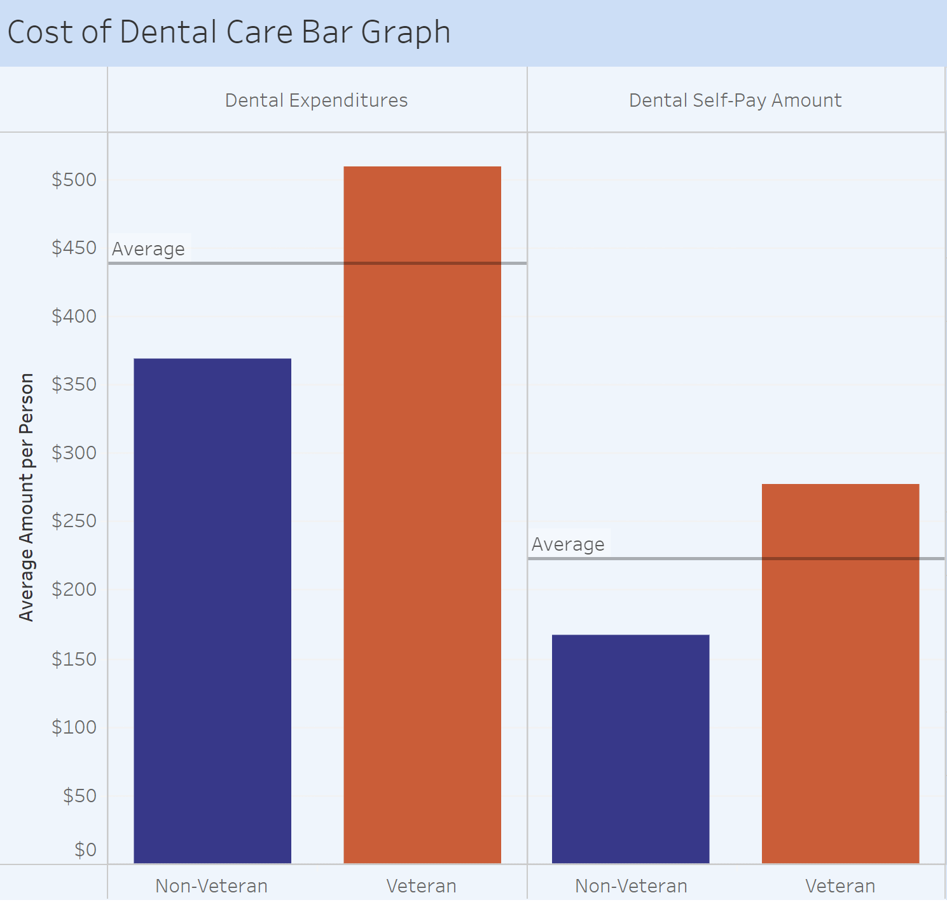
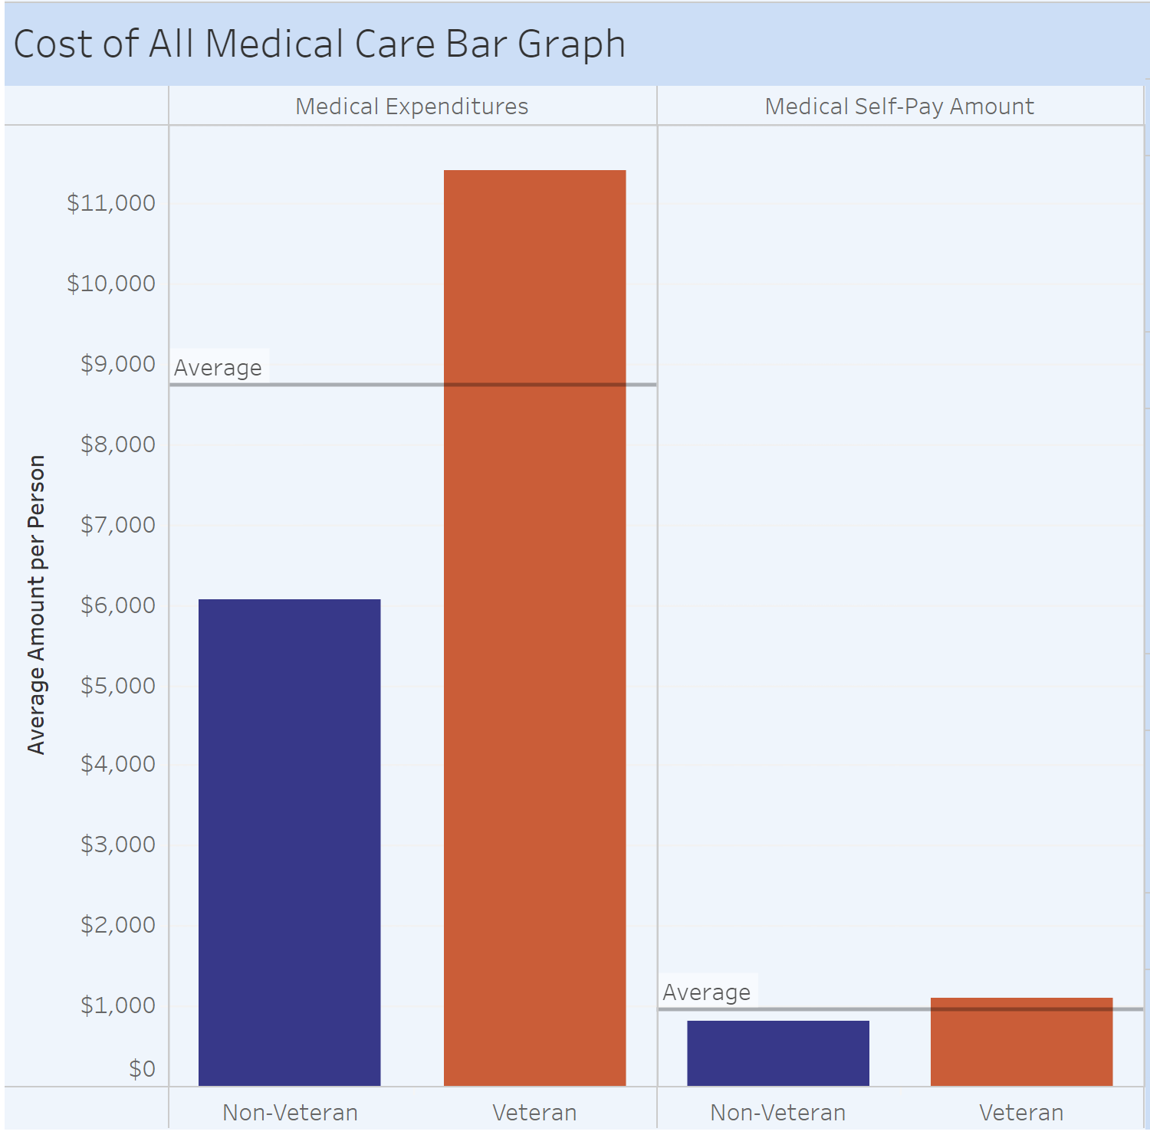

Slide 16
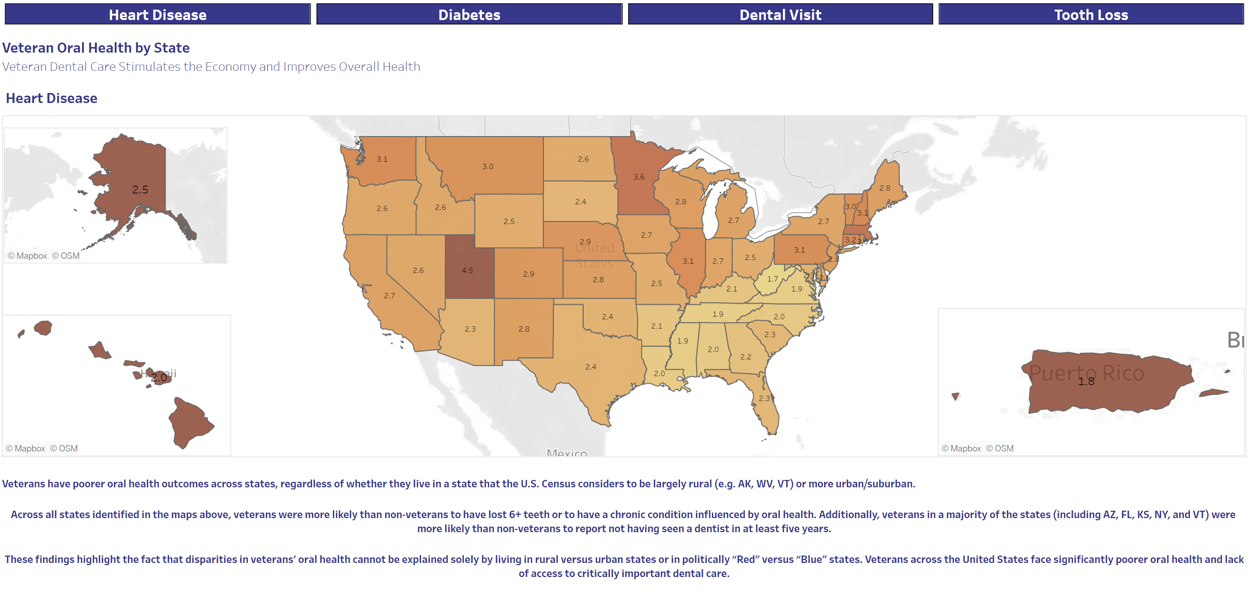

Slide 17
