Slide 1
Integration of Oral Health into Primary Care: Importance of Patients’ Perceptions and Attitudes
Kelly Schroeder, Rebekah Mathews, Caroline McLeod, Adrianna Sonnek, Dustin Holloway, and Eric Tranby
Notes:
Thank you Dr.Tranby. Hello and welcome.

Slide 2
Disclosures
Kelly Schroeder, Rebekah Mathews, Caroline McLeod, Adrianna Sonnek, Dustin Holloway, or Eric Tranby
Financial Disclosure: Speakers do not have any relevant financial relationships to disclose.
The NC Oral Health Section Continuing Education Program is responsible for ensuring the content, quality, and scientific integrity of all continuing education activities.
No commercial support has been received for this continuing education activity.
Notes:
The authors have no conflicts of interest to disclose

Slide 3
Learning Outcomes
Describe the MORE Care medical-dental integration model and alternative payment methods.
Discuss which patient-level and social determinants of health variables are associated with the need for a dental referral.
Understand the importance of patient perspectives for sustainable medical-dental integration models.
Notes:
The objectives of this segment of the presentation are to help set the framework for medical dental integration and how various types of data collection, especially patient information and patient perspectives are important for sustainable programs.

Slide 4

Medical Oral Expanded (MORE) Care
Oral Health Assessments and Services
Dental Referral
Dental Care
Medical Setting
Notes:
Specifically we will be talking about the medical dental integration program referred to as MORE Care (Medical Oral Expanded Care). The goals of MORE Care are to integrate oral health competencies into primary medical care settings with the help from community partners such as state and community oral health coalitions, state offices of rural health, universities, and other state-based entities. When initiating this program, medical clinicians are trained on specific oral health screenings and prevention measures, provided learning tools and resources, and receive ongoing support to implement a sustainable program. Areas medical teams will focus on include identifying patients at risk for oral health issues, work with patients to create self-managed oral health goals, apply fluoride varnish, and refer patients to a dental provider. Program success is dependent on building internal relationships and having clinician buy in to the importance of oral health care as well as building external relationships with oral health professionals who are willing and able to accept patient referrals. Identifying patients with oral health needs and not being able to find a dental home for them does not equal success.

Slide 5
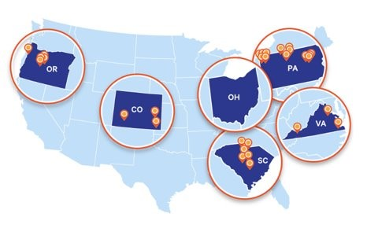
MORE Care Partnerships and Iterations
Notes:
More Care was developed in 2015 and has been piloted in four states—South Carolina, Pennsylvania, Colorado, and Oregon. The initial focus of MORE Care was on rural areas, specifically working with rural primary care clinics.
Our newest iteration of MORE Care is in the process of being launched in Ohio and will involve four primary care clinics and four dental clinics that will include FQHC’s and private practice giving a diverse perspective on this program’s strengths and weaknesses.

Slide 6
Quantitative Data
Baseline Data
Monthly demographic, electronic health records (EHR),and dental referrals
Quarterly financial reports
Value Based Care Readiness Surveys (Pre-Post)
Control Groups
Baseline Data
Intervention
Outcome Data
Notes:
Patient demographic data and social determinants of health (SDOH) will be collected from clinics electronic health records (EHR). Baseline clinical metrics are collected to determine which oral health screenings and services were already being provided by medical clinics to compare with any changes after program implementation. Clinical metrics will be captured regarding the number of patients with documented oral health assessments, oral health self-management goals, fluoride varnish applications, and referrals to a dental provider for two years following program training completion.
Clinical financial measures will also be collected and analyzed to assist with alternative payment method protocols and determine financial impacts of employing oral health care into a medical setting.

Slide 7

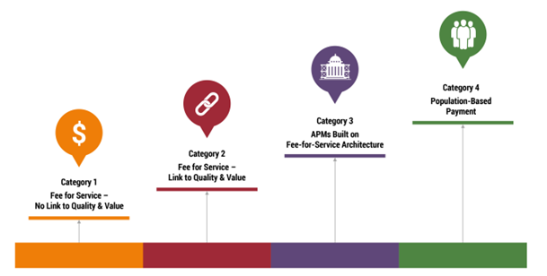
Alternative Payment Design Structure
Notes:
Here is a graphic of the CMS Payment Model for alternative payment methods to encourage medical and dental delivery of care that is patient-centered quality care instead of payment for quantity of care, in other words, value-based care. In this model, designed and published by the Health Care Payment Learning & Action Network, the first category is the traditional fee for service model that has no link to quality and value of care. As the various models of payment increase the end goal is to reach payment methods that reward clinicians for promoting health and having healthy patients.
Medical and dental delivery of care generally operate and are paid for separately, leading to a lack of continuity in care. This can be perpetuated by the traditional fee-for-service payment system which tends to reward high volume, low-value, invasive procedures. The goal of MORE Care with offering alternative payment methods is to reward medical clinics when they include oral health as part of their routine protocol and to network with oral health professionals for continued patient care.
In the MORE Care payment model, participating medical and dental practices will receive normal reimbursement for covered patient procedures while additional incentives can be earned based on program metrics reported on by practices. This method reflects category 3 in this model.

Slide 8
Clinical Measures Show Improvement
Reported as Mean Percentages.
Notes:
Clinical measures of patient demographics, social determinants of health, clinical services, and financial reporting helps determine if a program is effective from a business and clinical perspective. This graph represents aggregated data from the previous iterations of MORE Care. The yellow represents baseline data for each of the measures of fluoride varnish application, patients participating in self-managed goals, and the administration of oral health risk assessments. The red represents improvement seen in these oral health services at 12 to 18 months after the program support systems were complete. It is easy to see from this graph the significant improvement in these areas overtime and that there was still an increase in these services after the program support had ended.

Slide 9
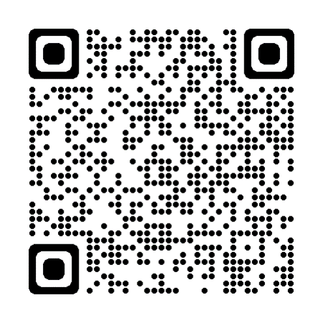
MORE Care: An evaluation of interprofessional oral health quality improvement initiative.
Kanan C, Ohrenberger K, Bayham M, Raskin SE, Tranby EP, Boynes S. MORE Care: an evaluation of an interprofessional oral health quality improvement initiative. J Public Health Dent. 2020 Sep;80 Suppl 2:S58-S70. doi: 10.1111/jphd.12407. Epub 2020 Oct 26. PMID: 33103760.
Notes:
Additional analysis and details from the previous slide can be found in this publication in the Journal of Dental Public Health.

Slide 10

What about patient experience?
Notes:
When developing a community-based health program, patient experience is a crucial part of determining the needs of a community. Before creating the MORE Care program, then customizing for each community, consumer needs, culture, and experiences were taken into consideration.

Slide 11
Available Data Sources for Consumer Insights
Thrive Analytics
County Health Rankings
Ohio Department of Health
Bureau of Labor Statistics
Illuminology
Opportunity Index
Outcomes & Utilization Data
Notes:
To learn more about the community needs for different areas of Ohio, extensive research was conducted to learn about state and county demographics, health and dental professional shortage areas, along with other oral and systemic health behavioral factors. Along with census data, patient surveys were also employed. Here is a list of some of the resources used to acquire this information. These are sources that can be found in other states and used to develop other community-based programs.

Slide 12
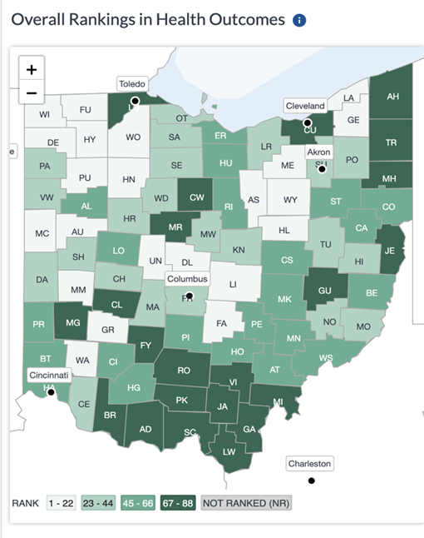
Northern Region
NW: Lacks access to dental care
NE: Worst health rankings
More likely to have proactive visit
Notes:
Recognizing differences within a population are important to optimize oral health delivery, which will be discussed in further detail from our other speakers. Here are a few high level oral and systemic health concerns that were identified for Ohio. The northwest region of the state had the least access to dental care. The northeast region had the worst health rankings even though they were more likely to have a proactive health care visit than their southern counterparts.

Slide 13
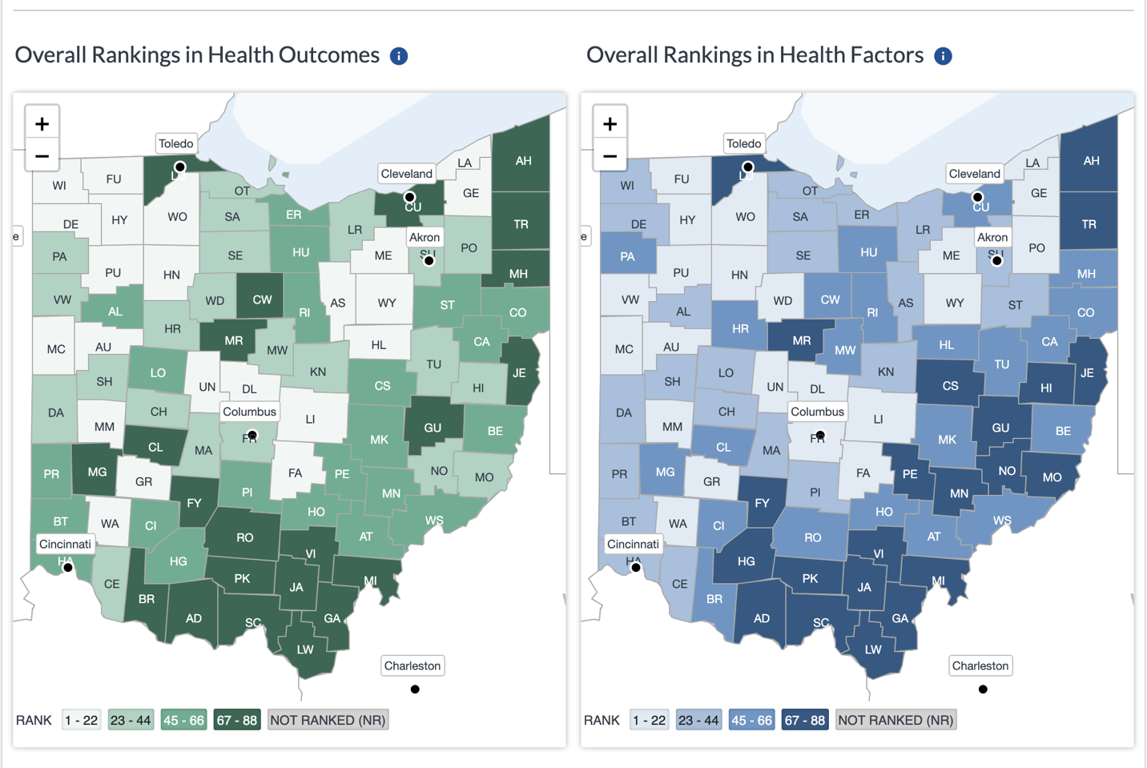
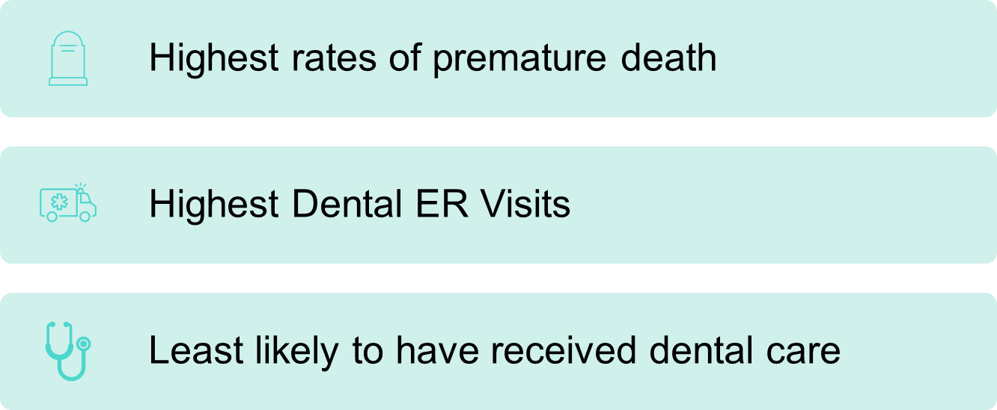
Southern Region
Notes:
The southern region had higher rates of premature death. This region was less likely to receive dental care and had higher dental emergency room visits than the northern region. Didn’t we just recognize the northern region had less access to dental care. This is an important finding to help understand not only dental care access but dental care utilization. One solution that might help is the Southwest and rural Ohio regions were the most interested in co-located medical and dental care.

Slide 14
Qualitative Data Interview Process
CareQuest Institute for Oral Health
Medical/Dental Clinics
Community Partners
CareQuest Institute for Oral Health
Medical/Dental Clinics
Patients
Control Clinics
Community Partners
Process I
(Before Implementation)
Process II
(After Learning and Implementation)
Outcome
(Long-term change after program ended)
Notes:
With the data collected and analyzed from quantitative data, consumer surveys, and consensus reports we should know exactly what patients want and providers should be willing and able to provide this care. Right? Well, we feel that an important piece of the puzzle is still missing and that is to hear directly from those who are involved with program planning, program implementation, and receiving care from the program. For the upcoming iteration of Ohio MORE Care a qualitative component has been added. Semi-structured interviews will be conducted during three different stages of the program to learn if all stakeholder needs and expectations, including patients and clinicians, are being met. The top portion of the graph indicates who will be interviewed. The lower half indicates when these individuals will be interviewed…during the beginning (process I), middle (process II), and/or after the program support has ended (outcome).

Slide 15
Clinical Perspective
Was the oral health conversation something patients came to expect?
“Patients appreciate when we do fluoride varnish applications or when we’re doing some education about it. It isn’t something patients expect but is important because dental health is part of overall health. Bringing those two things together is definitely important.”
Notes:
An example of how qualitative research can contribute to program design is a testimonial by a Physician’s Assistant from St. Luke’s rural medical clinic in Eastern Pennsylvania. This person began working at St. Luke’s after the initial MORE Care program had ended. As part of her onboarding process, she was trained on MORE Care using the resources provided by CareQuest Institute and was expected to integrate the oral health concepts into her daily routine. Since the beginning of the initial MORE Care initiative implementation, St Luke’s has doubled the number of clinics employing MORE Care and have plans to continue to grow this initiative within their hospital system. This helps demonstrate sustainability.

Slide 16
Conclusion
Medical-Dental Integration can and should be part of routine care.
Successful MDI programs include:
Identification of systems barriers and systems strengths.
Community, clinician, and patient buy-in.
Allied health professional networking and referral system.
Accurate collection of quantitative data.
Accurate collection of qualitative data.
Creating systems change to reduce barriers.
Notes:
In conclusion a successful medical integration program needs to include identifying all aspects of patient needs, support team buy-in, well defined and manageable data collection systems, and evaluation of the program that includes perspectives those who are involved with various aspects of the program but most importantly those who are at the receiving end of the program. The patient.

Slide 17
Kelly Schroeder, RDH, MS
Health Science Specialist
CareQuest Institute
KSchroeder@carequest.org

