Slide 1
Oral Health Integration Attitudes on Medical-Dental Collaboration
NOHC April 11 , 2022
Adrianna Sonnek, MPH, Lisa J. Heaton, PhD, Madhuli Thakkar-Samtani, BDS, MPH,
Eric P. Tranby, PhD

Slide 2
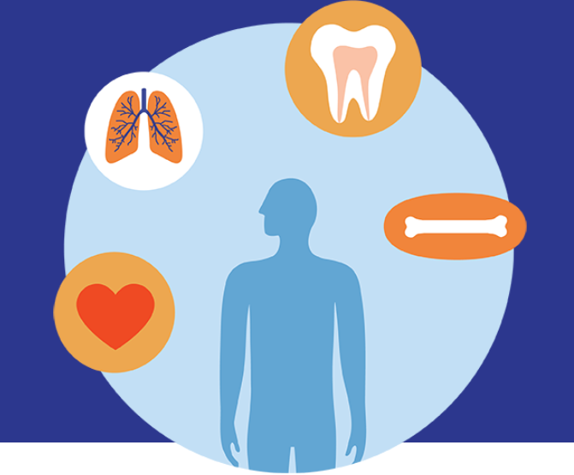
Medical-Dental Integration
Approach to care that integrates dental medicine into primary care and behavioral health
Also promotes practice of dental providers integrating services such as screenings for chronic diseases into their care
Encourages providers to create comprehensive care plans for the whole person
RESULTS ARE PRELIMINARY, NOT FOR DISTRIBUTION WITHOUT PERMISSION OF CAREQUEST INSTITUTE

Slide 3
State of Oral Health Equity in America (SOHEA) Survey
The SOHEA survey is a nationally representative, probability-based survey of adult consumer attitudes, experiences, and behaviors on oral health.
Data was collected by the National Opinion Research Center (NORC) in two rounds, collected from January to February of both 2021 and 2022
Survey was conducted online and by telephone through NORC’s AmeriSpeak® Panel
Sampling strata based on age, race/Hispanic ethnicity, education and gender
Additional sample of American Indian/Native Alaskan panelists in 2022
Limited to adults age 18+; one response per household
Sample Unit: 17603
Weighted Cumulative Response rate: 4%
Margin of Error: ±1.75 percentage points
Final Sample size after exclusions: 2021 N=5,320 2022 N=5,682
RESULTS ARE PRELIMINARY, NOT FOR DISTRIBUTION WITHOUT PERMISSION OF CAREQUEST INSTITUTE

Slide 4
DentaQuest-Enrolled Provider Research Survey
CareQuest Institute for Oral Health assembled research panel of DentaQuest- enrolled providers to conduct quarterly online surveys
Research panel was sent to 22,075 providers
575 agreed to participate in panel (2.5% participation rate)
Eligibility was assessed by age (18+), and having a high degree of familiarity with selected topics
Research panel substantially similar to dental population in terms of geographic distribution, specialty and gender
Results taken from results fielded March-April 2021
377 dental providers participated
Response rate of 63% of those that agreed to participate in research panel
RESULTS ARE PRELIMINARY, NOT FOR DISTRIBUTION WITHOUT PERMISSION OF CAREQUEST INSTITUTE

Slide 5
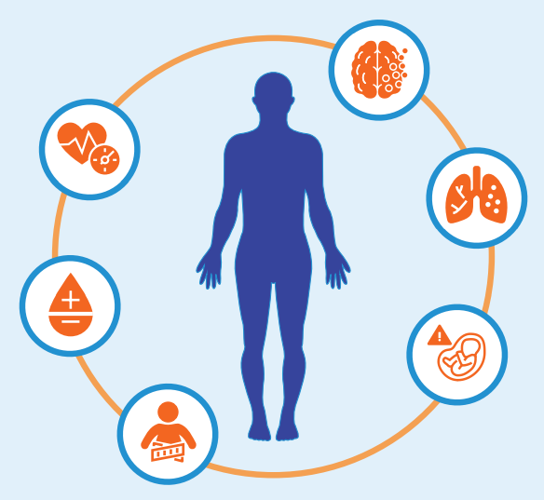
Oral Health and Overall Health are Inextricably Linked
of consumers acknowledge connection between health of the mouth and the rest of the body
96%
Dental care still largely siloed from medical care
CDC estimates that integrating basic health screenings into a dental setting could save health care system up to $100 million annually¹
Consumers and providers both expressed lack of integration and a desire for increased interprofessional collaboration
1. “Return on Investment,” Centers Disease Control and Prevention, accessed November 22, 2021, https://www.cdc.gov/oralhealth/fast-facts/roi/index.html.
RESULTS ARE PRELIMINARY, NOT FOR DISTRIBUTION WITHOUT PERMISSION OF CAREQUEST INSTITUTE

Slide 6
Which of the following diseases or conditions do you believe are linked to the health of your teeth, mouth, and gums?select all
RESULTS ARE PRELIMINARY, NOT FOR DISTRIBUTION WITHOUT PERMISSION OF CAREQUEST INSTITUTE

Slide 7
How often has your primary medical doctor asked about your oral health?
Consumers report current lack of collaboration
How often has your primary oral health provider asked about your overall health?
RESULTS ARE PRELIMINARY, NOT FOR DISTRIBUTION WITHOUT PERMISSION OF CAREQUEST INSTITUTE
Notes:
In 2022, 22% of consumers report their primary oral health provider rarely or never ask about their overall health.
62% of consumers indicated that their primary medical doctor rarely or never asked about their oral health.

Slide 8
Lack of integration
Nearly a third (32%) of people who went to the ER for dental care or pain/discomfort in the mouth were NOT referred to an oral health provider following their visit

Slide 9
Providers also report lack of collaboration
45% of responding oral health providers report “rarely” integrating care with clinicians outside of dentistry
Only 14% report that integrating their care with clinicians outside of dentistry was part of their “daily” practice
Almost a fourth (24%) of participating oral health providers report currently implementing interprofessional practice
RESULTS ARE PRELIMINARY, NOT FOR DISTRIBUTION WITHOUT PERMISSION OF CAREQUEST INSTITUTE
Notes:
Most consumers surveyed report that they are comfortable receiving health screenings from their oral health provider

Slide 10
Health screenings in dental offices are an underutilized opportunity for preventive care
Over 90% of oral health providers surveyed agree that dietary habits should be assessed in all patients
RESULTS ARE PRELIMINARY, NOT FOR DISTRIBUTION WITHOUT PERMISSION OF CAREQUEST INSTITUTE
Notes:
Most consumers surveyed report that they are comfortable receiving health screenings from their oral health provider

Slide 11
Low levels of screening seen despite comfort level

Slide 12
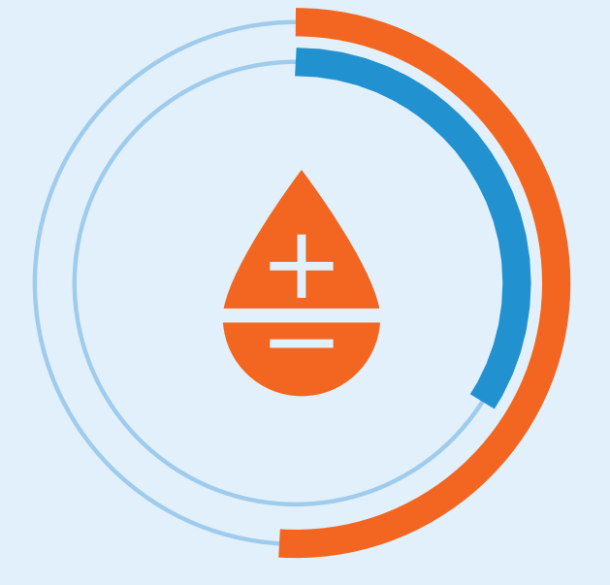
Oral health providers need tools to perform health screenings
While only one third (34%) of oral health providers indicate that they currently screen patients for diabetes,
more than half (51%) of providers indicate that they would be more willing to screen if they had better tools to identify those at risk
RESULTS ARE PRELIMINARY, NOT FOR DISTRIBUTION WITHOUT PERMISSION OF CAREQUEST INSTITUTE

Slide 13
Dental Offices are an untapped resource for vaccine distribution
More than a third of adults (34%) report that they would be comfortable receiving a COVID-19 vaccine or booster from a dentist
Nearly a third of adults (31%)
report that they would consider receiving a flu vaccine from their dentist
RESULTS ARE PRELIMINARY, NOT FOR DISTRIBUTION WITHOUT PERMISSION OF CAREQUEST INSTITUTE

Slide 14
Co-location of dental and medical services is desired
Most consumers (72%)
say they prefer to have their medical and dental insurance provided through the same insurance company
This was especially true for people of color with 77% of Black adults and 75% or Hispanic adults, compared to 68% of white adults.
People in the lowest income category (<$30,000) were most likely to agree (75%) compared to those in the highest income category (>$100,000) who were least likely to agree (66%).
RESULTS ARE PRELIMINARY, NOT FOR DISTRIBUTION WITHOUT PERMISSION OF CAREQUEST INSTITUTE

Slide 15
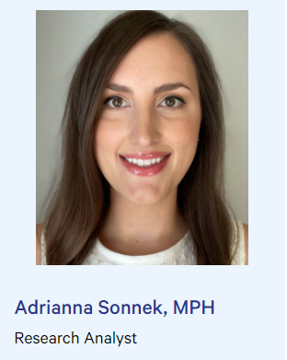
Find additional resources on our website: CareQuest.org
asonnek@carequest.org

